Slide 1

Auto-Loan
Pricing Engine
Kun Hu

Slide 2
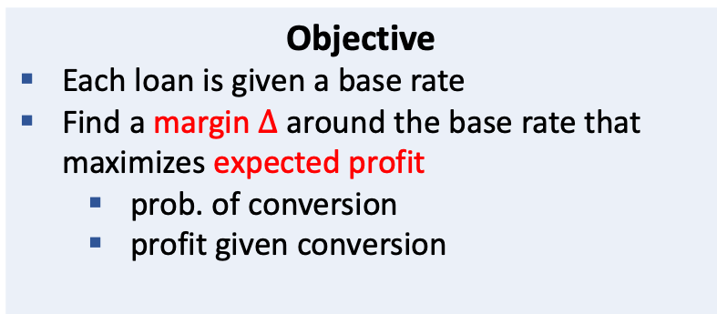
Auto Pricing Engine: Find the profit-maximizing interest rate for each loan in real-time
Objective
Each loan is given a base rate
Find a margin $∆$ around the base rate that maximizes expected profit
prob. of conversion
profit given conversion
Data
Observational data
Loan, applicants and vehicle info
Economic variables
A/B testing data
4 treatment and 1 control variant
Each has different margin
Method
Two-part model
conversion rate at the base price
LightGBM
sensitivity around the base price
Causal ML
Impact
20,000 loans per day
$20k ~ $30k per application (face value)
$24m projected lift in annual profits

Slide 3
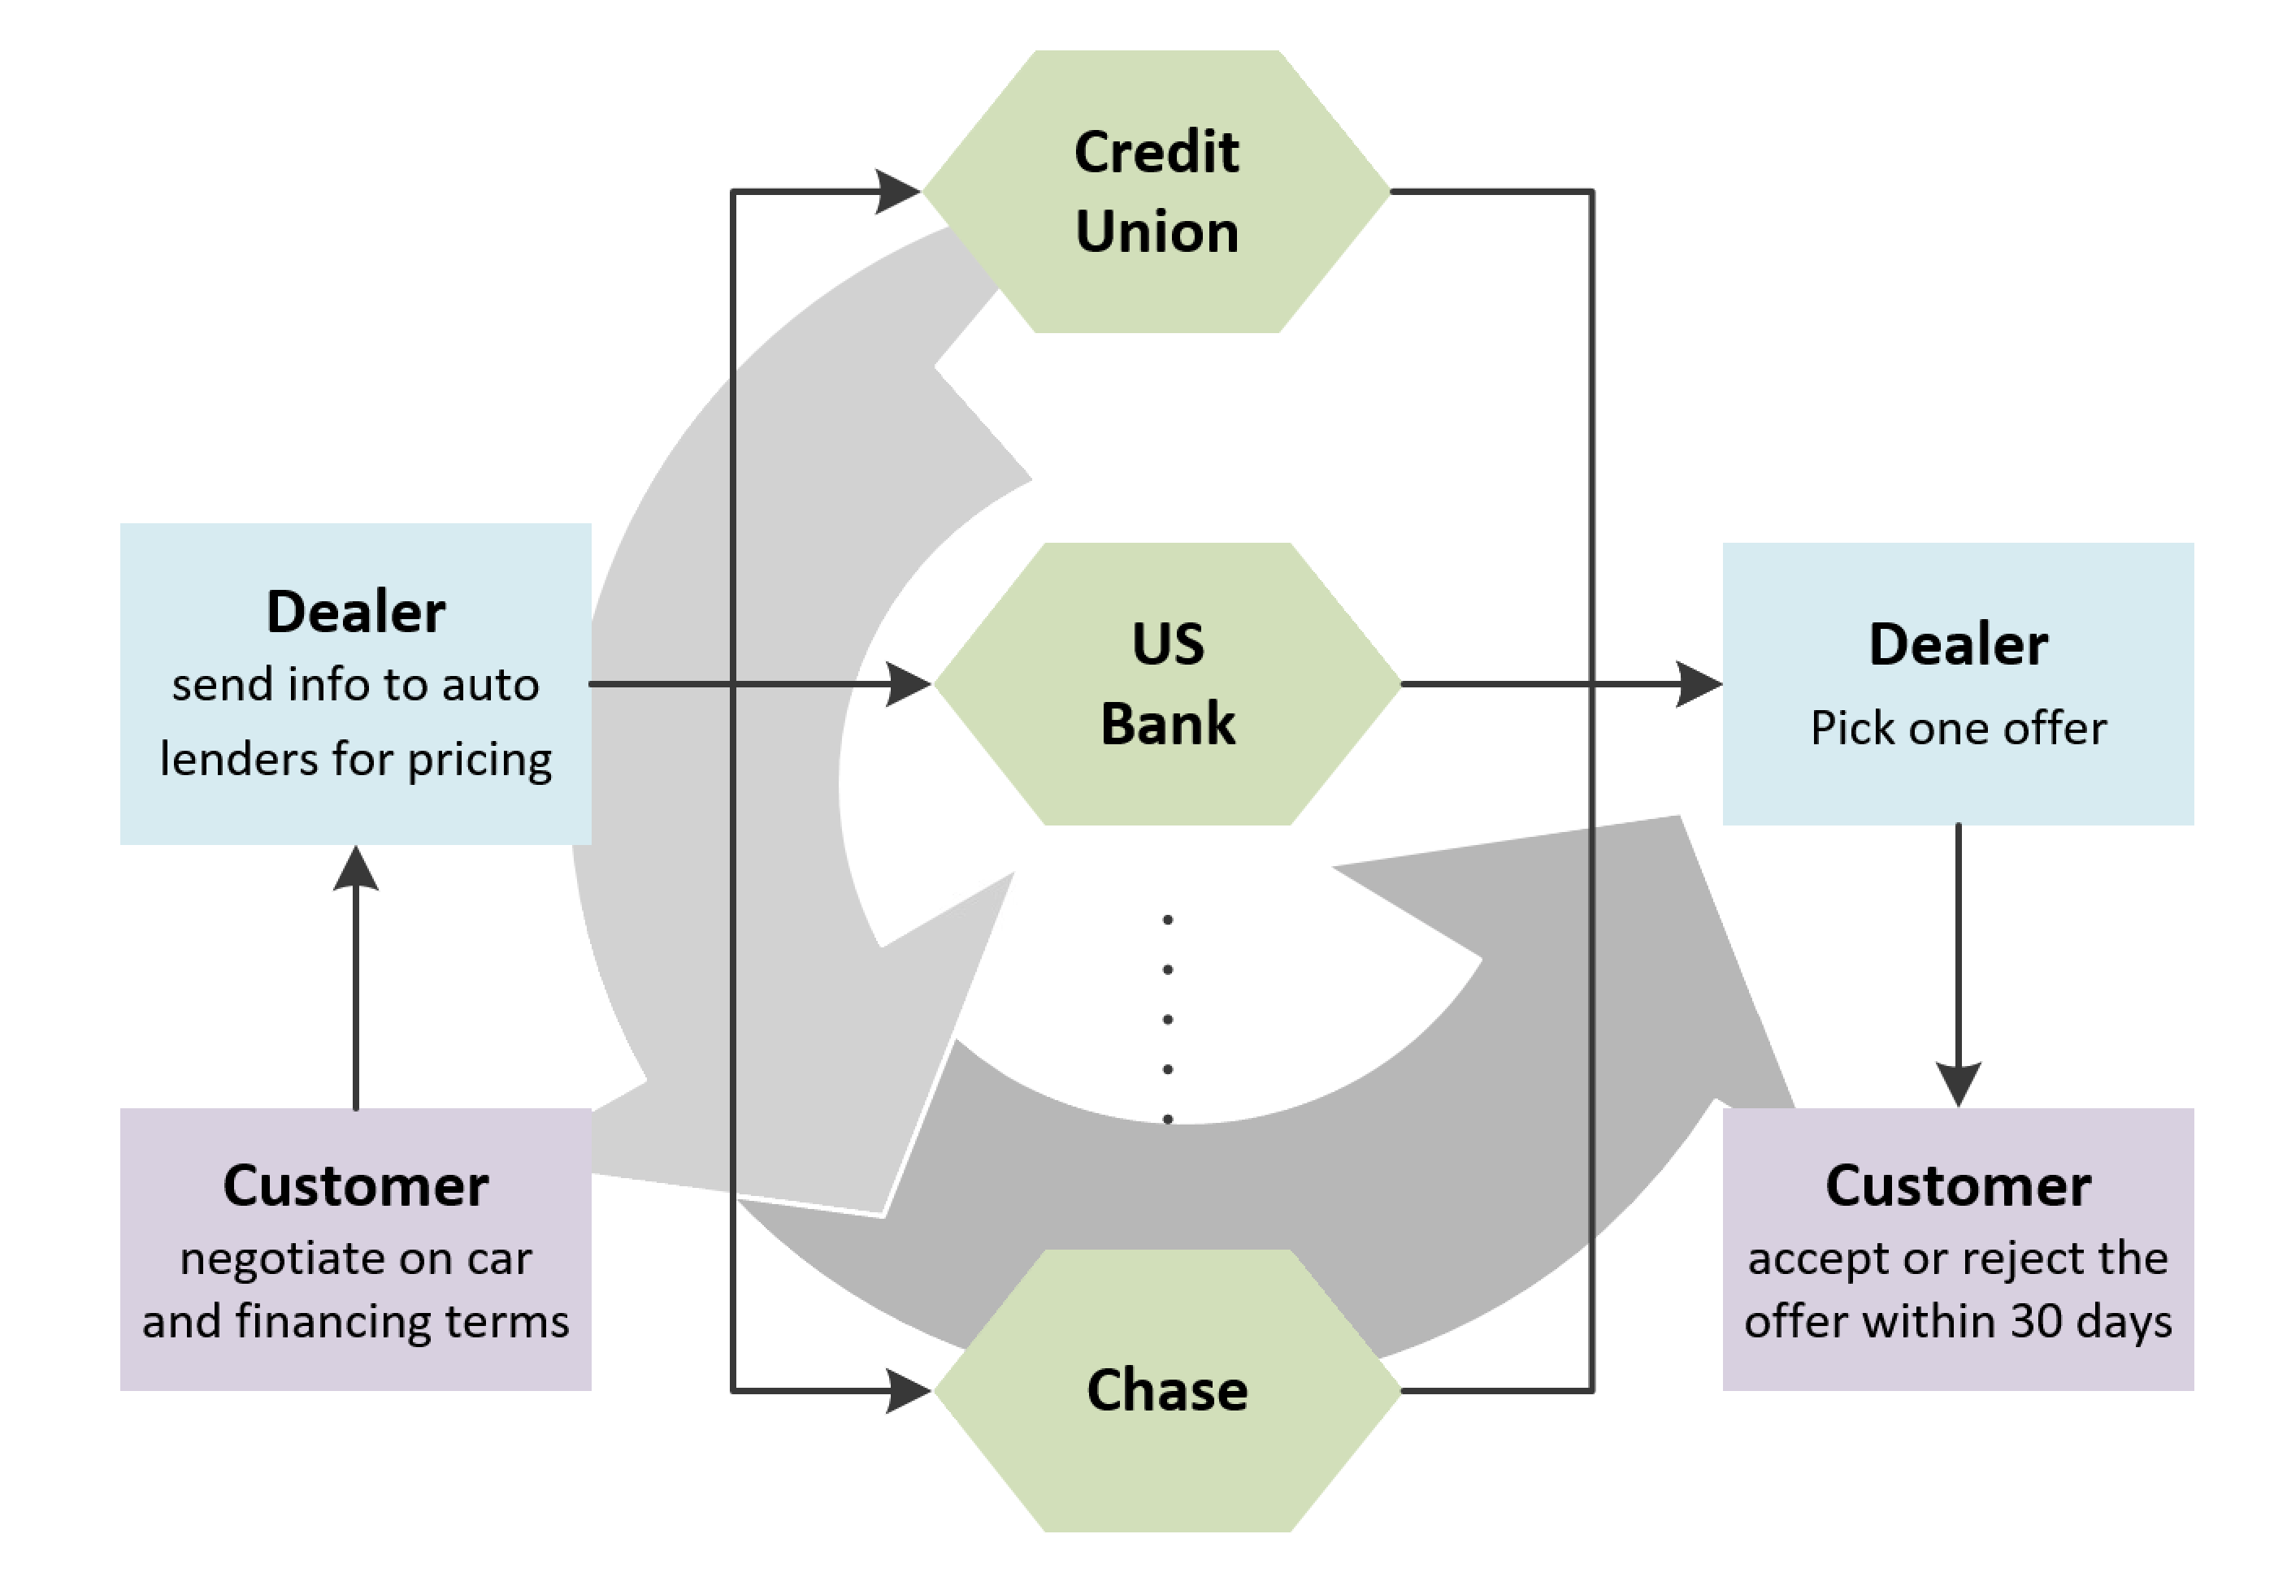
Business Process Overview

Slide 4




Key Model Drivers
Price Info
Base rate
Margin
Application Info
Loan amount
Term
Credit score
...
Vehicle Info
Make
Model
Age
...
Other Info
Market rate
Historical moving averages
...

Slide 5
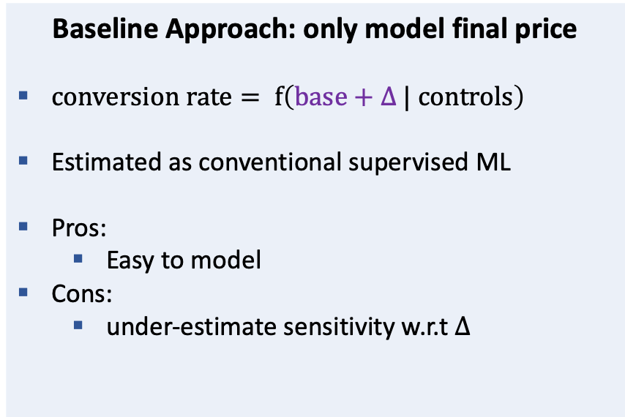
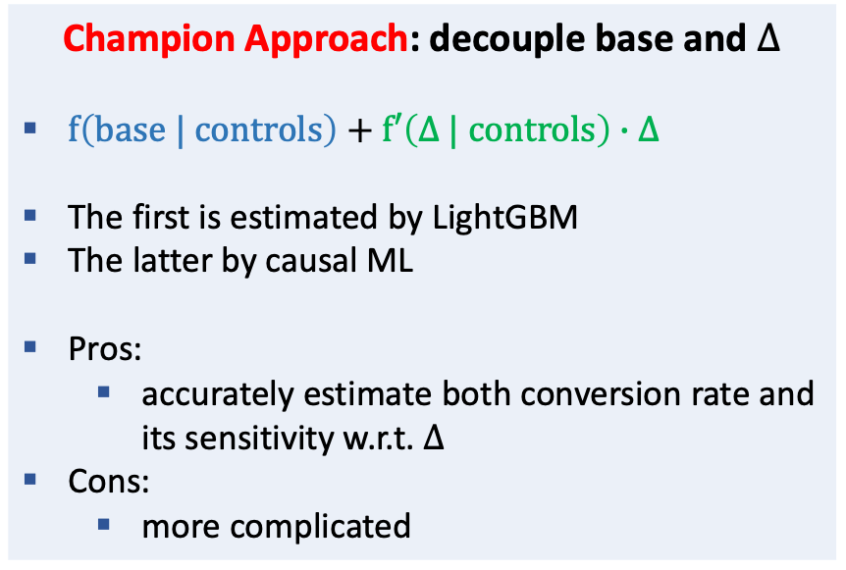
Two-part model design to estimate both the level and sensitivity of conversion rate
Question: what is the conversion rate when the interest rate changes by $∆$? – this is causality!
Baseline Approach: only model final price
$conversion rate= f\left(base+∆ | controls\right)$
Estimated as conventional supervised ML
Pros:
Easy to model
Cons:
under-estimate sensitivity w.r.t $∆$
Champion Approach: decouple base and $∆$
$f\left(base | controls\right)+f′\left(∆ | controls\right)∙∆$
The first is estimated by LightGBM
The latter by causal ML
Pros:
accurately estimate both conversion rate and its sensitivity w.r.t. $∆$
Cons:
more complicated

Slide 6

Evaluation: Offline and Online Metrics
Offline Evaluation
Conversion model accuracy at loan level
Brier score (MSE)
AUC ROC
...
Conversion model accuracy at agg. level
Time series of actual vs. predicted
segment-wise break-down
Simulated lift in profits
Back-testing
Online Evaluation
Primary
Conversion rate
Realized profit
...
Counter/tracking
Credit risk
...

